Slide 1
Probabilistic Programming
Marius Popescu
popescunmarius@gmail.com
2022 - 2023

Slide 2
Introduction

Slide 3
What is Probabilistic Programming
Probabilistic programming languages aim to unify general purpose programming with probabilistic modeling; literally, users specify a probabilistic model in its entirety (e.g., by writing code that generates a sample from the joint distribution) and inference follows automatically given the specification
http://www.probabilistic-programming.org
Probabilistic programming is about performing Bayesian inference using the tools of computer science: programming language for model denotation and statistical inference algorithms for computing the conditional distribution of program inputs that could have given rise to the observed program output
A programming paradigm that provides a language based on random variables and
stochastic control flow to construct a broad class of probabilistic models

Slide 4
Frequentist Vs Bayesian Approaches in Statistics
Frequentist
Bayesian
Assume that probability is the long-run frequency of events
The probability of plane accidents under a frequentist philosophy is interpreted as the long-term frequency of plane accidents.
How to assign probabilities to outcomes of presidential elections? The election itself only happens once!
Interpret a probability as measure of belief, or confidence, of an event occurring. Simply, a probability is a summary of an opinion. An individual who assigns a belief of 0 to an event has no confidence that the event will occur; conversely, assigning a belief of 1 implies that the individual is absolutely certain of an event occurring.
This definition agrees with the probability of a plane accident example, for having observed the frequency of plane accidents, an individual's belief should be equal to that frequency, excluding any outside information.
Similarly, under this definition of probability being equal to beliefs, it is meaningful to speak about probabilities (beliefs) of presidential election outcomes: how confident are you candidate A will win?

Slide 5
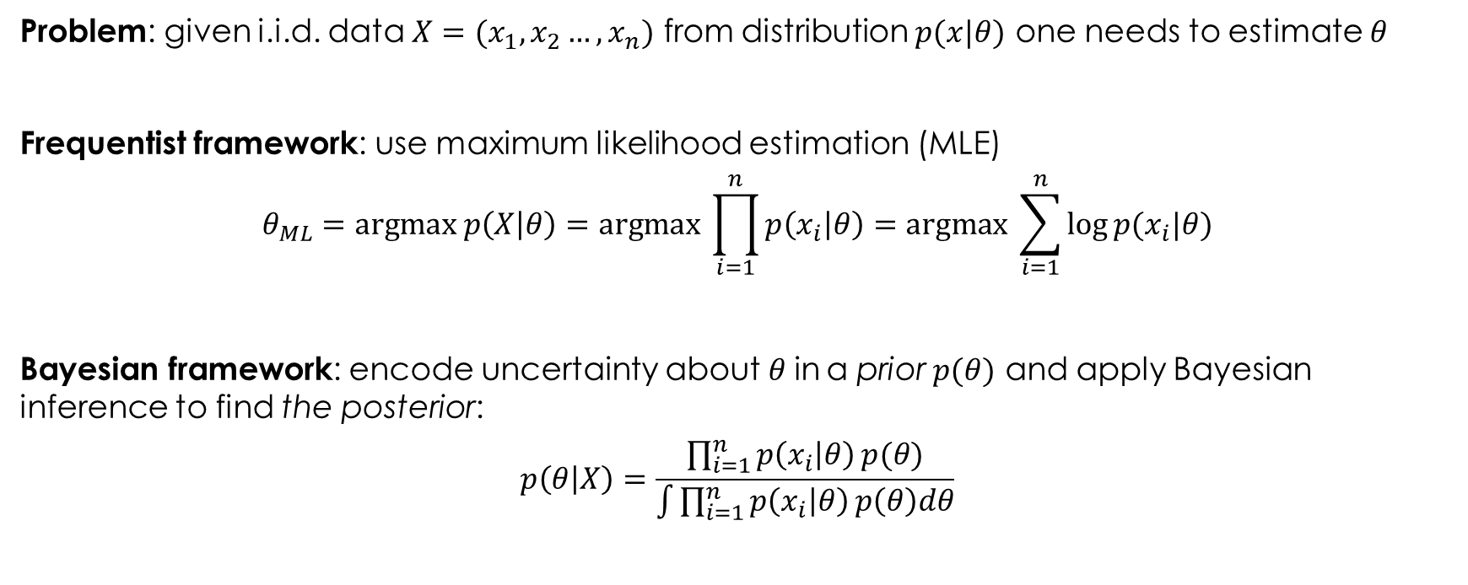
(Bayesian) Probabilistic Modeling
Problem: given i.i.d. data $X=(x_{1},x_{2}…,x_{n})$ from distribution $p(x|θ)$ one needs to estimate $θ$
Frequentist framework: use maximum likelihood estimation (MLE)
$$θ_{ML}=\text{argmax} p\left(X | θ\right)=\text{argmax} \prod_{i=1}^{n}{p\left(x_{i} | θ\right)=\text{argmax} \sum_{i=1}^{n}{\log{p(x_{i}|θ)}}}$$
Bayesian framework: encode uncertainty about$θ$in a prior $p(θ)$ and apply Bayesian inference to find the posterior:
$$p\left(θ | X\right)=\frac{\prod_{i=1}^{n}{p\left(x_{i} | θ\right)}p(θ)}{\int{\prod_{i=1}^{n}{p\left(x_{i} | θ\right)}p\left(θ\right)dθ}}$$

Slide 6
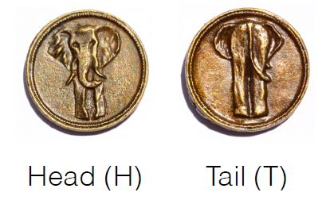
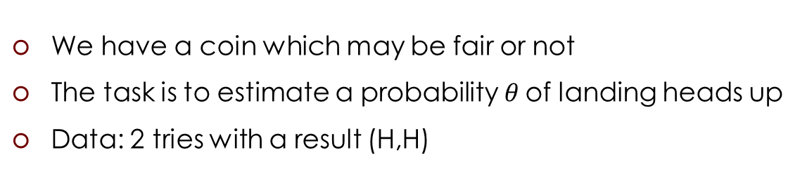
Example: Coin Tossing
We have a coin which may be fair or not
The task is to estimate a probability$θ$ of landing heads up
Data: 2 tries with a result (H,H)

Slide 7

Example: Coin Tossing
We have a coin which may be fair or not
The task is to estimate a probability$θ$ of landing heads up
Data: 2 tries with a result (H,H)
Frequentist framework:
In all experiments the coin
landed heads up
$θ_{ML}$=1
The coin is not fair and
always lands heads up

Slide 8
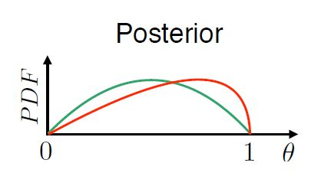
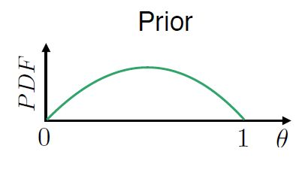
Example: Coin Tossing
We have a coin which may be fair or not
The task is to estimate a probability$θ$ of landing heads up
Data: 2 tries with a result (H,H)
Bayesian framework:

Slide 9
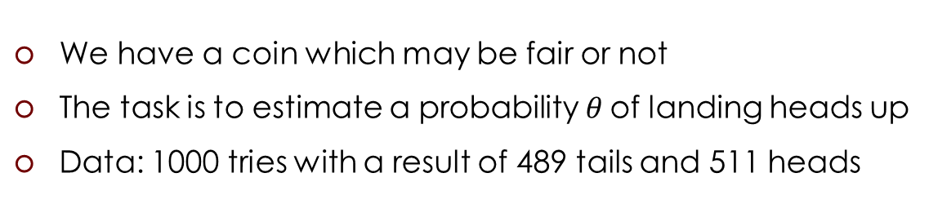
Example: Coin Tossing
We have a coin which may be fair or not
The task is to estimate a probability$θ$ of landing heads up
Data: 1000 tries with a result of 489 tails and 511 heads
Both frameworks:
Sufficient amount of data
matches our expectations
The coin is fair

Slide 10
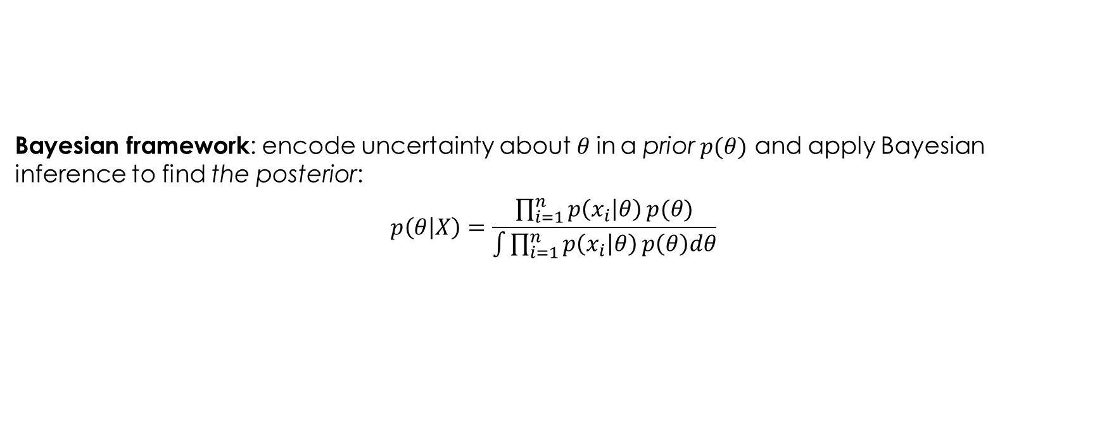
Bayesian Modeling: The Problem
Bayesian framework: encode uncertainty about$θ$in a prior $p(θ)$ and apply Bayesian inference to find the posterior:
$$p\left(θ | X\right)=\frac{\prod_{i=1}^{n}{p\left(x_{i} | θ\right)}p(θ)}{\int{\prod_{i=1}^{n}{p\left(x_{i} | θ\right)}p\left(θ\right)dθ}}$$
May be intractable

Slide 11
What is Probabilistic Programming
Probabilistic programming languages are to the Bayesian or probabilistic machine learning as automated differentiation tools are to the deep learning
The rapid grow of deep learning has been triggered largely by the emergence of programming language tools that automate the tedious and troublesome derivation and calculation of gradients for optimization
Probabilistic programming aims to build and deliver a toolchain that does the same for probabilistic machine learning

Slide 12
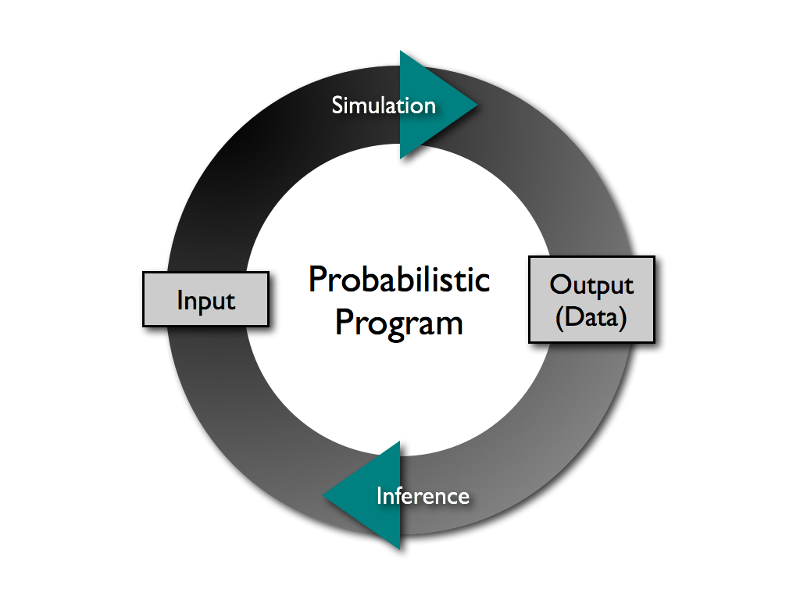
What is Probabilistic Programming

Slide 13
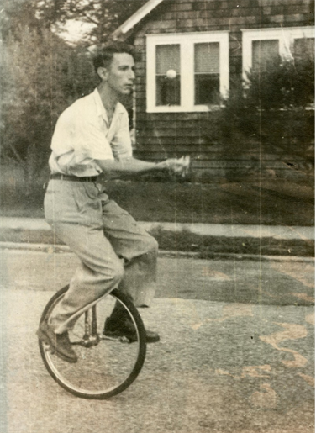
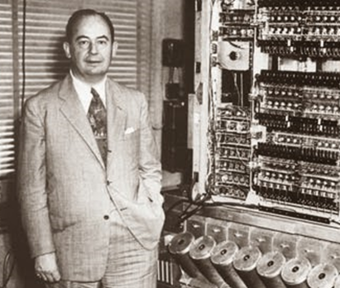
Some History
Von Neumann, J. (1956).
Probabilistic logics and the synthesis of reliable organisms from unreliable components
Shannon, C. E. (1958).
Von Neumann’s contributions to automata theory.

Slide 14
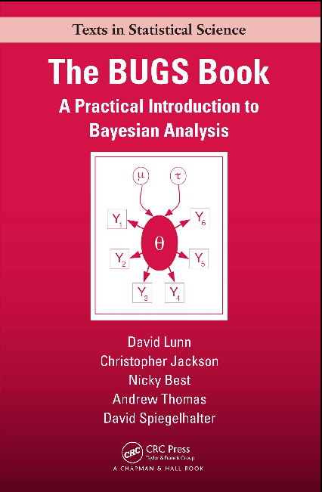
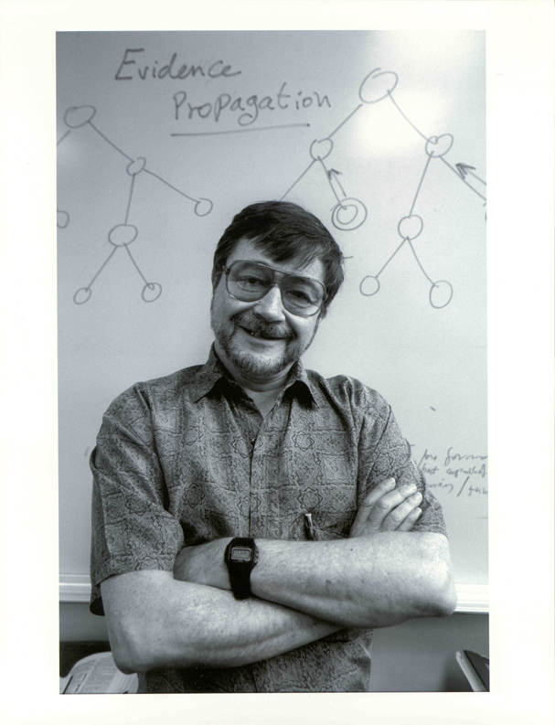
Some History
Pearl, J. (1982).
“Reverend Bayes on inference engines: A distributed hierarchical approach,” Proceedings, AAAI-82
The BUGS (Bayesian inference Using Gibbs Sampling) project is concerned with flexible software for the Bayesian analysis of complex statistical models using Markov chain Monte Carlo (MCMC) methods. The project began in 1989 in the MRC Biostatistics Unit, Cambridge.

Slide 15

Is it useful? Is it hot?
Why to study probabilistic programming?

Slide 16
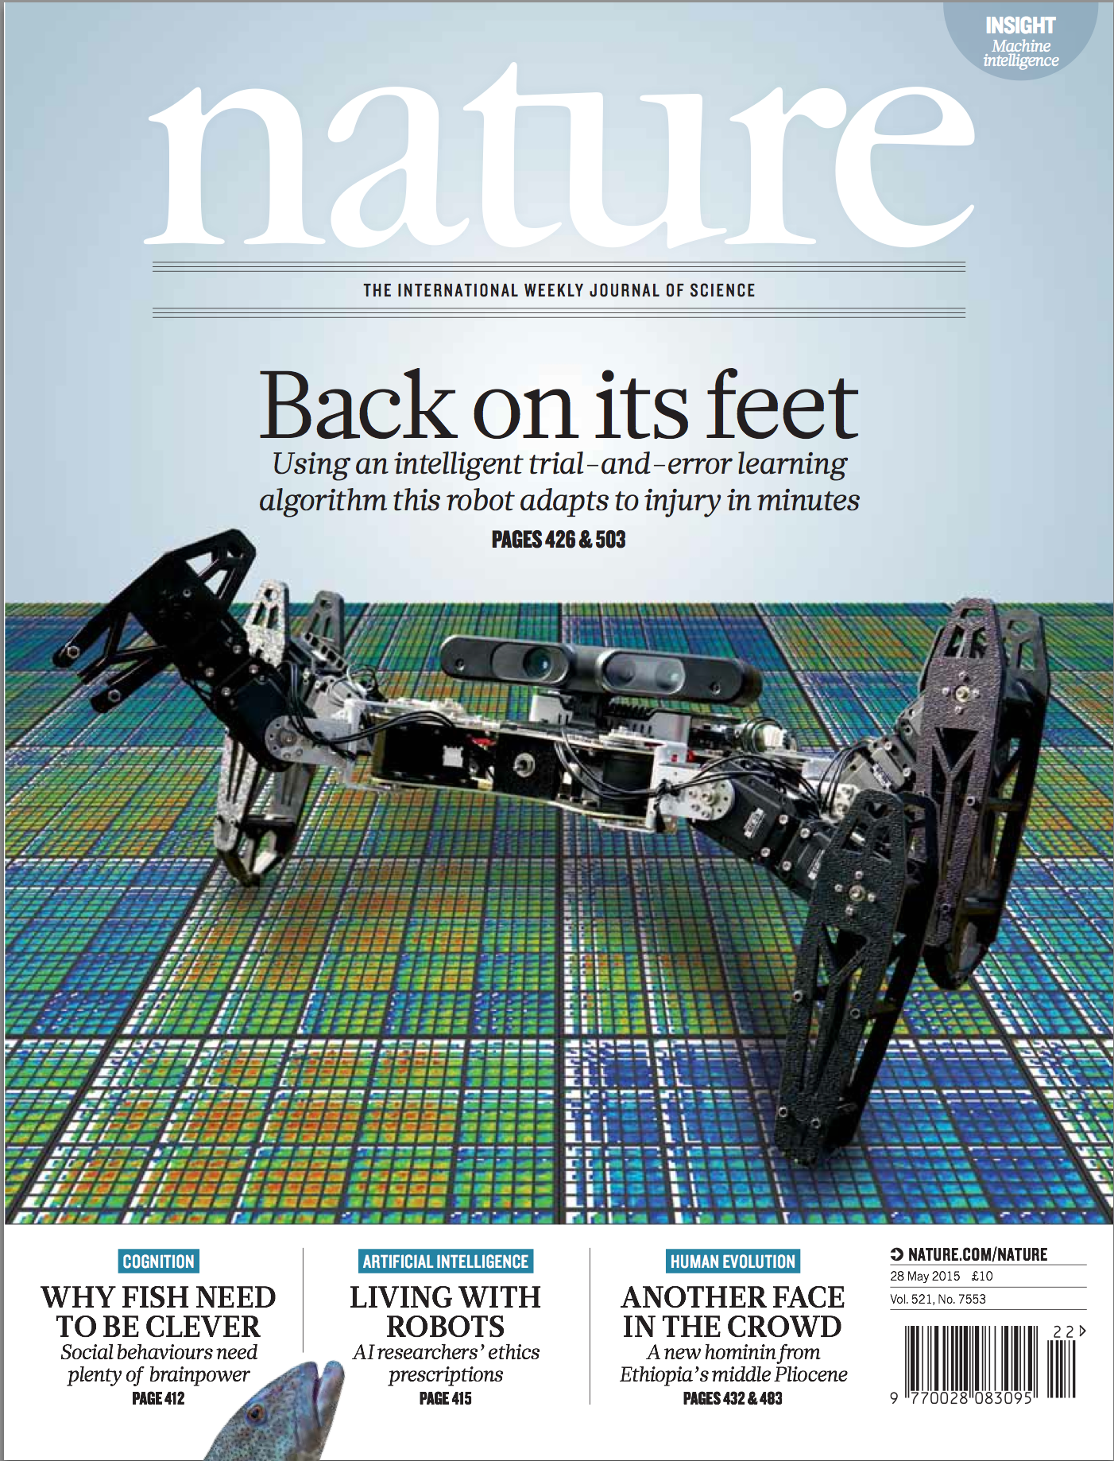

Slide 20
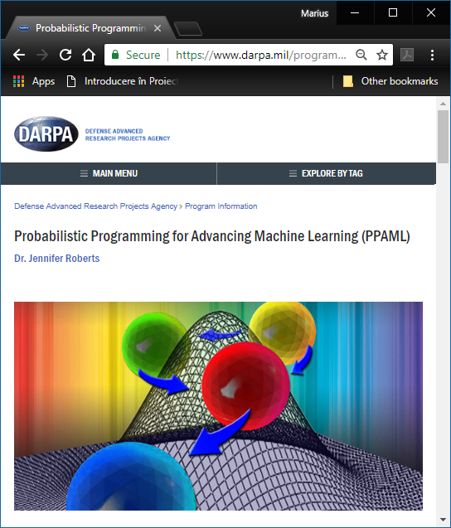
PPAML started in March 2013 and is scheduled to run 46 months, with three phases of activity through 2017

Slide 21
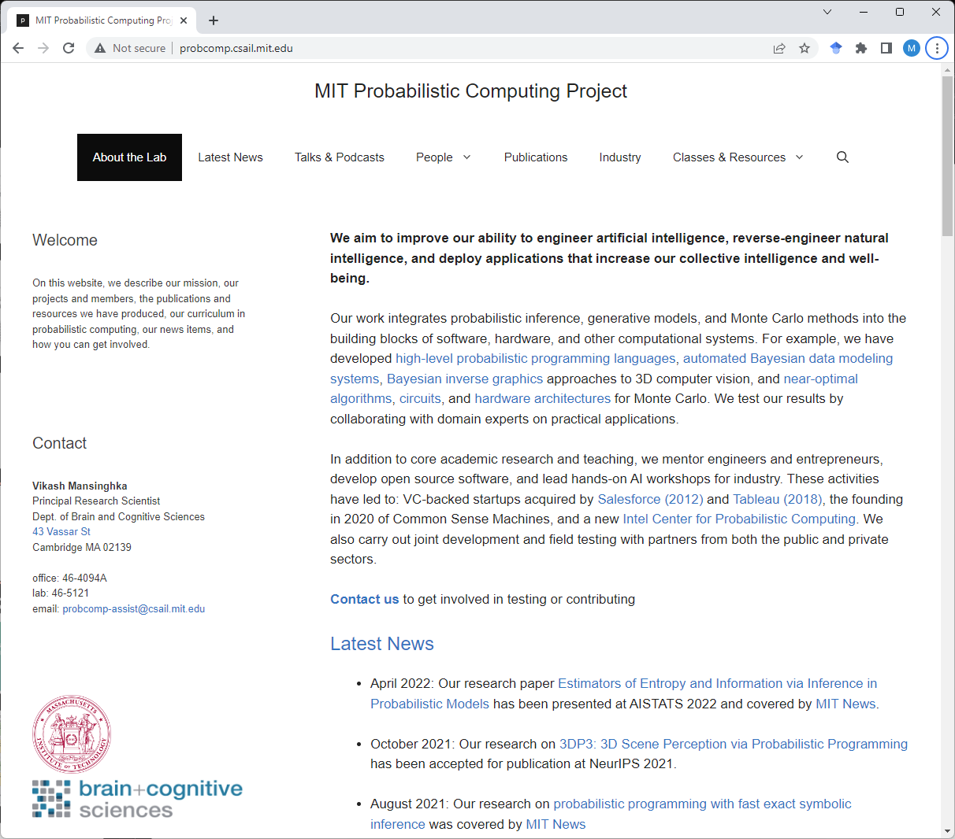

Slide 22
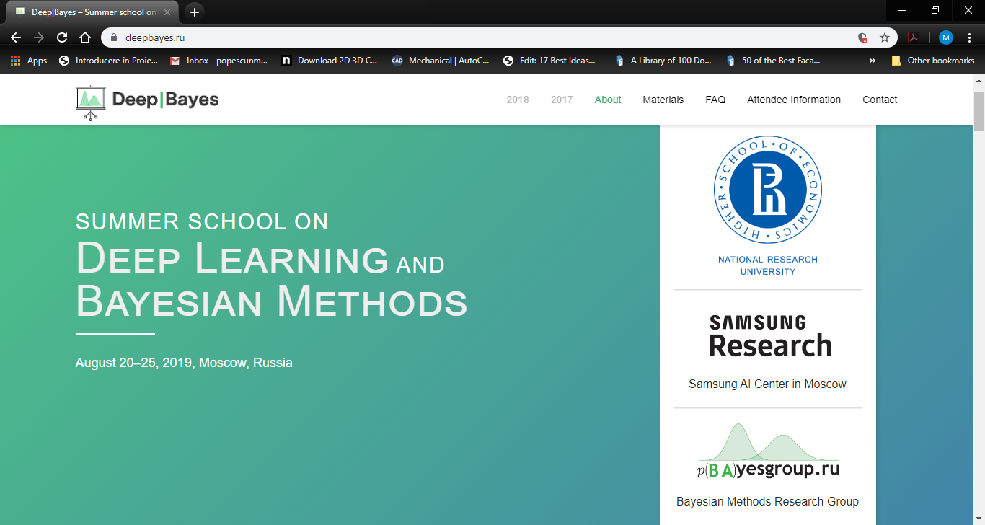

Slide 23
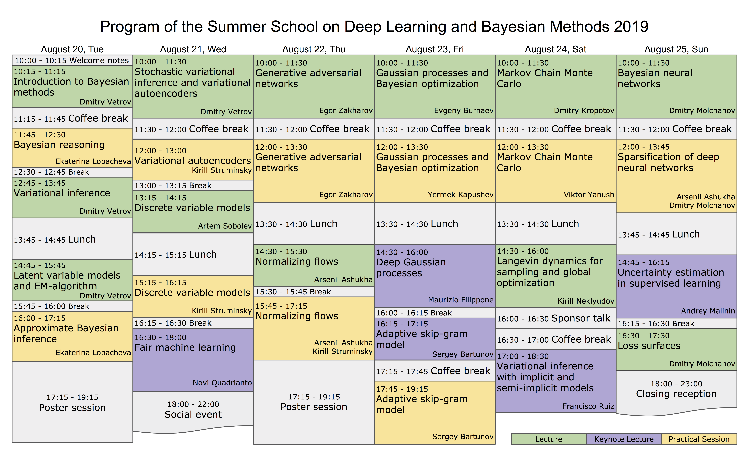

Slide 24
Some Accomplishments

Slide 25
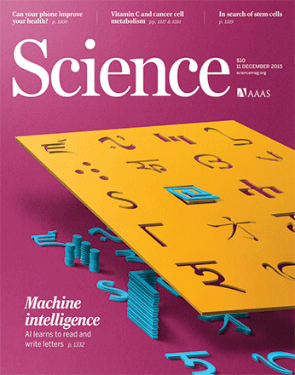

Humans and machines were given an image of a novel character (top) and asked to produce new versions.

Slide 26

Common sense and context affect letter form perception: (i) m vs u and n. (ii) the same line segments are interpreted as N or S depending on occluder positions (iii) perception of the shapes aids the recognition .

Slide 27
The Course

Slide 28
Course Goal & Objectives
Understanding of the basic concepts and mechanisms of the probabilistic programming
Ability of using a probabilistic programming framework
Using probabilistic programming for building a probabilistic model of a phenomenon, inferring the model parameters given the model and the data, criticizing the model

Slide 29






Tools
PyMC: a probabilistic programming library for Python
(https://www.pymc.io/welcome.html)
Edward: A library for probabilistic modeling, inference, and criticism
(http://edwardlib.org/)
TensorFlow Probability: A library for probabilistic reasoning and statistical analysis
(https://www.tensorflow.org/probability)
PYRO: Deep Universal Probabilistic Programming
(https://pyro.ai/)
Gen: An open-source stack for generative modeling and probabilistic inference
(https://www.gen.dev)

Slide 30
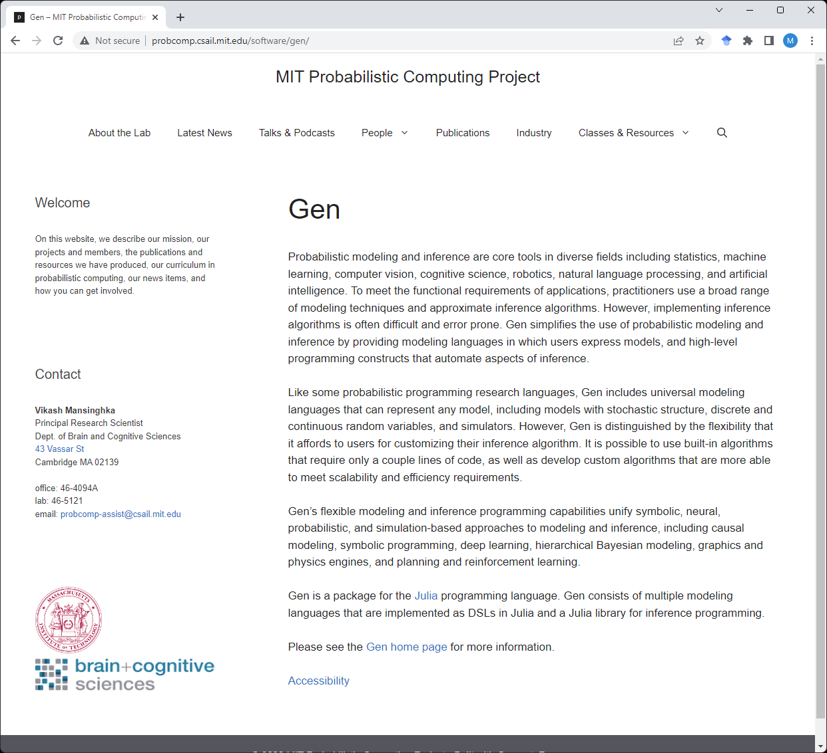

Slide 31
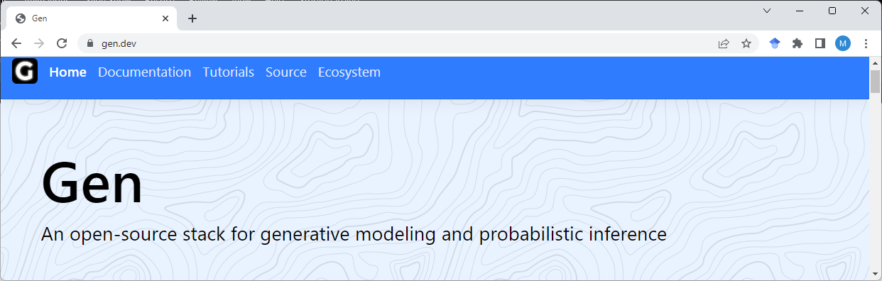
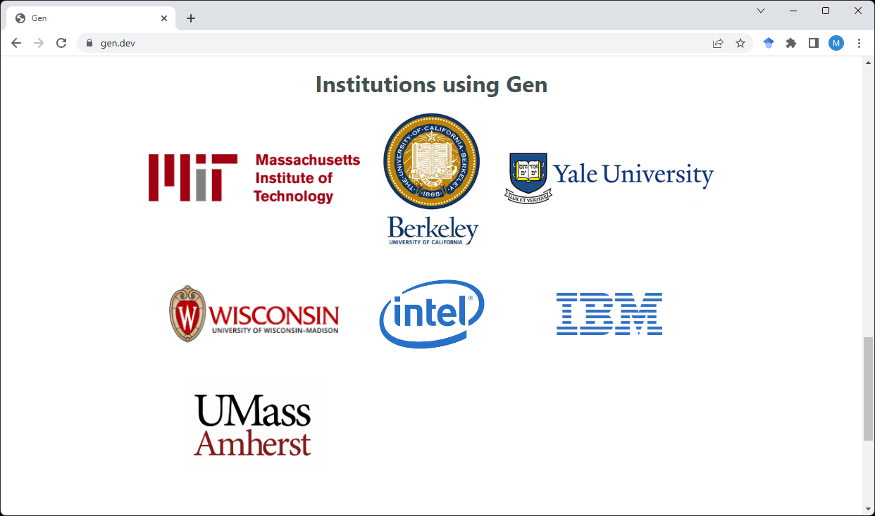

Slide 32
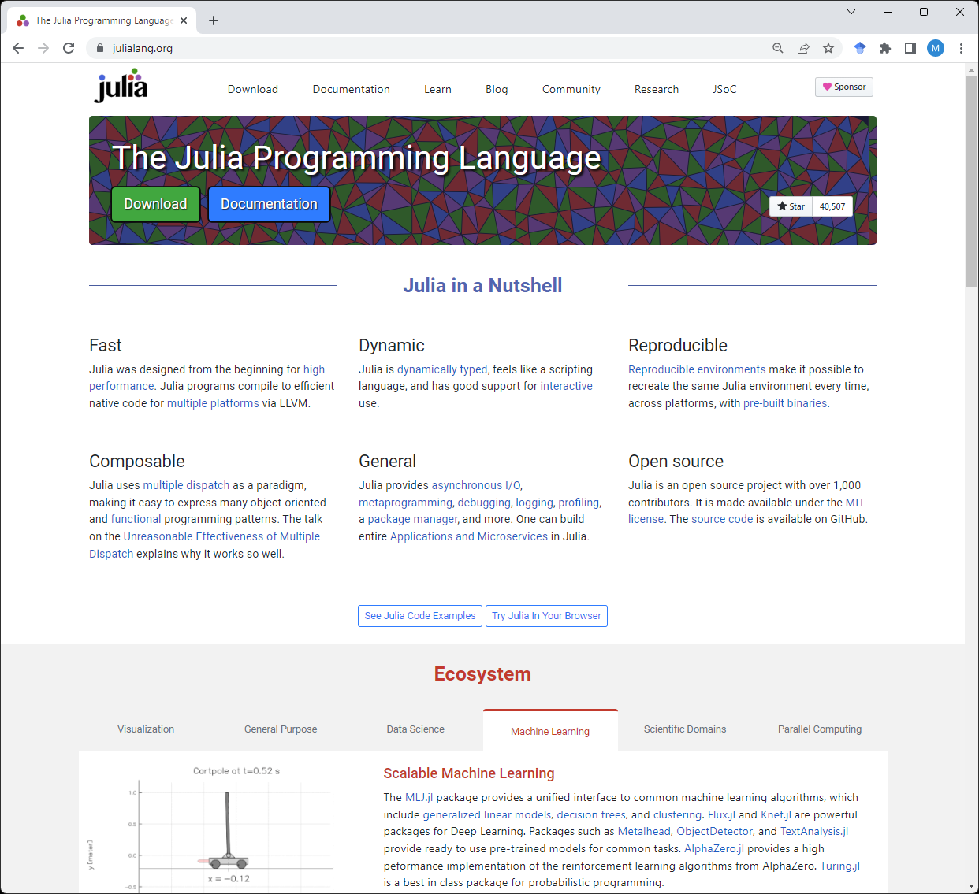

Slide 33
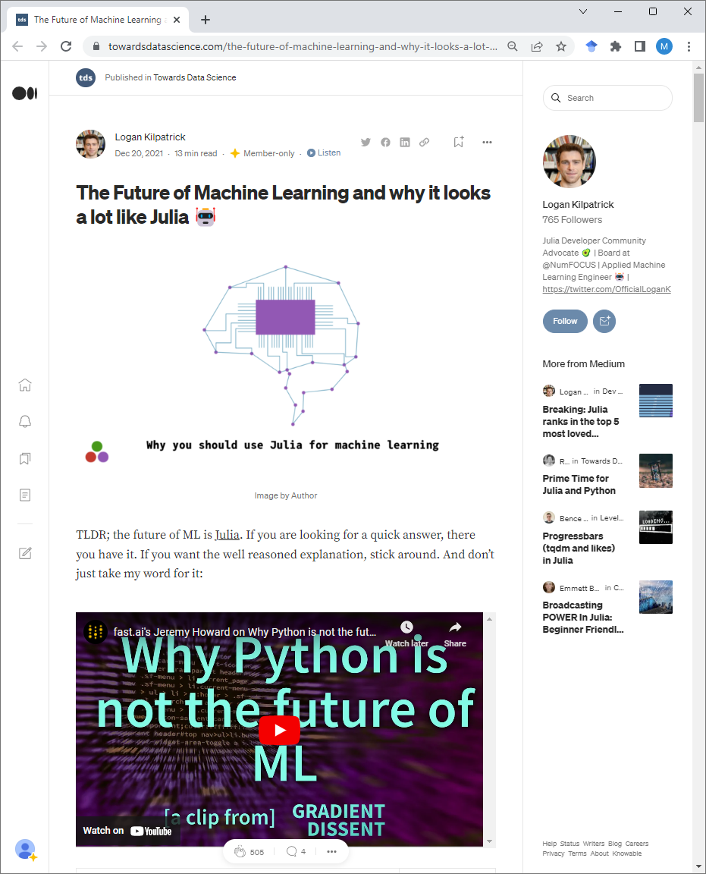

Slide 34
Why Julia?
Julia has been designed from the ground up to improve a trade-off that has long existed in programming—fast coding versus fast execution.
On the one side, Julia allows the developer to code in a dynamic, high-level language similar to Python, R, or MATLAB.
On the other side, with minimum effort, developers can write programs in Julia that run (almost) as fast as programs written in C.

Slide 35
Wouldn’t it be better, though, to optimize existing languages rather than create a new language from scratch?.
Python (and, in general, all the current dynamic languages) was designed before the recent development of just-in-time (JIT) compilers, and hence it offers features that are not easy to optimize. The optimization tools either fail or require complex workarounds in order to work (PyPy, Cython, Numba).
Julia is designed keeping performance as the central focus of its development. Type determinations and conversions take significant time in most interpreted languages. Julia is fundamentally a Just-in-Time (JIT) compiled language. The types are determined during runtime and several code segments are compiled based on the types. A multi-dispatch architecture1 based on data types ensures the most efficient implementation is invoked.

Slide 36
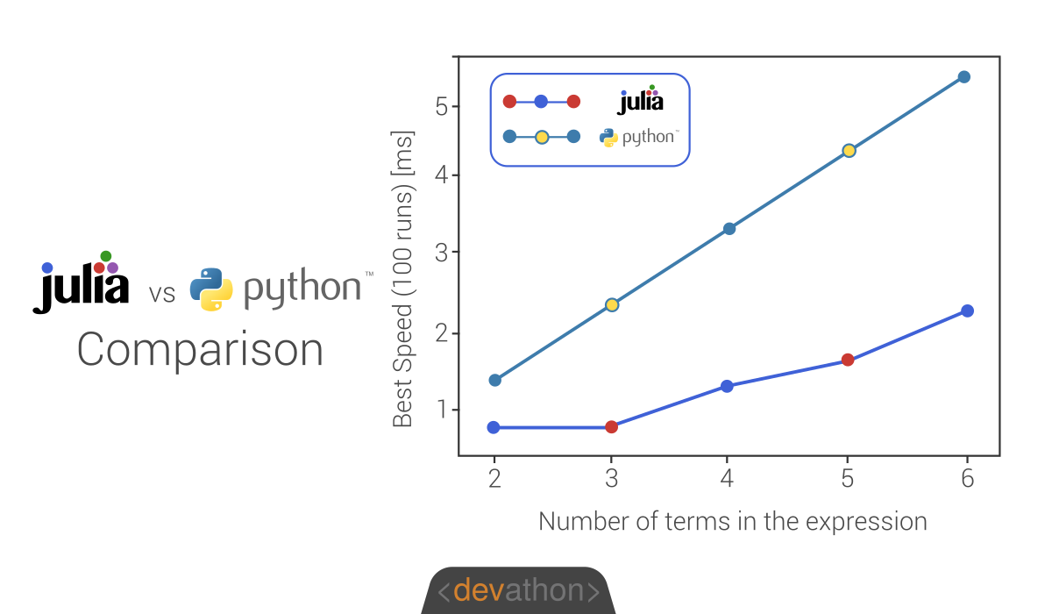

Slide 37

Infamous Python GIL (Global Interpreter Lock)

Slide 38
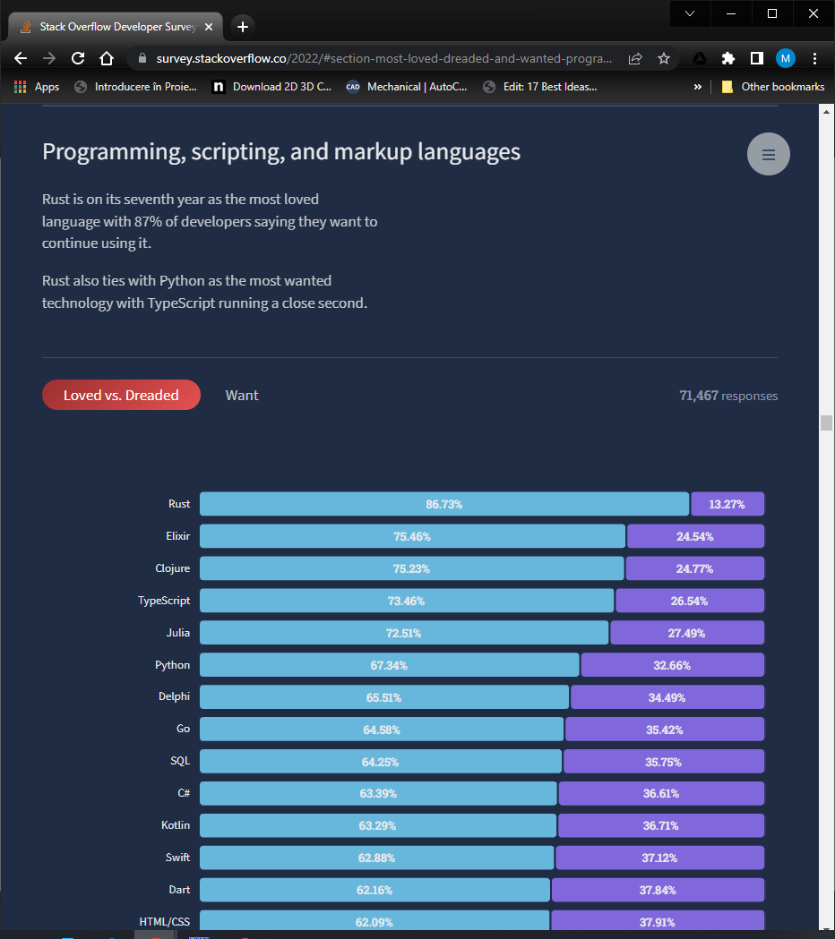

Slide 39
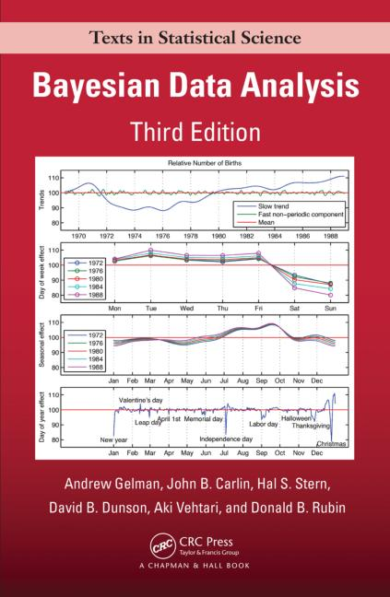
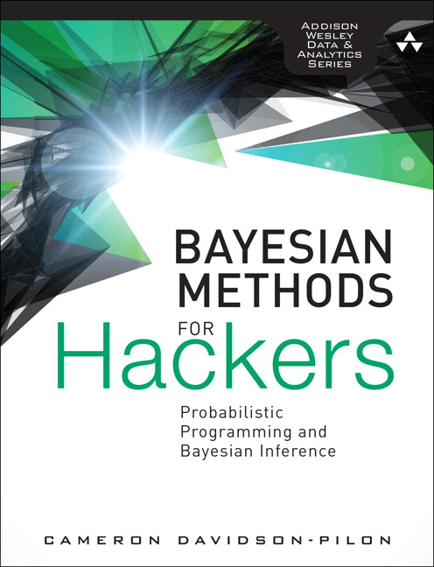
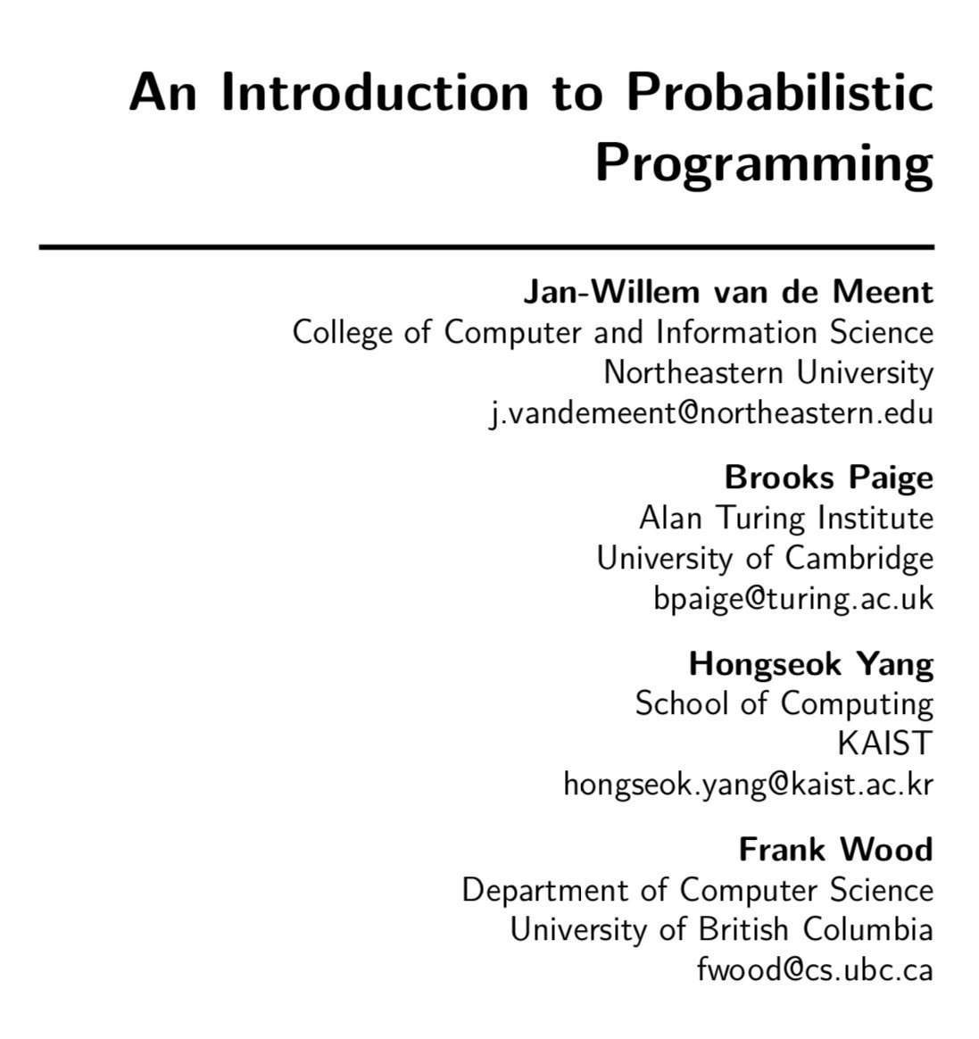
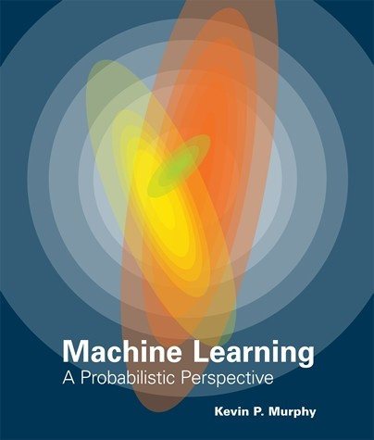
Bibliography
https://arxiv.org/abs/1809.10756
https://github.com/CamDavidsonPilon/Probabilistic-Programming-and-Bayesian-Methods-for-Hackers

Slide 40
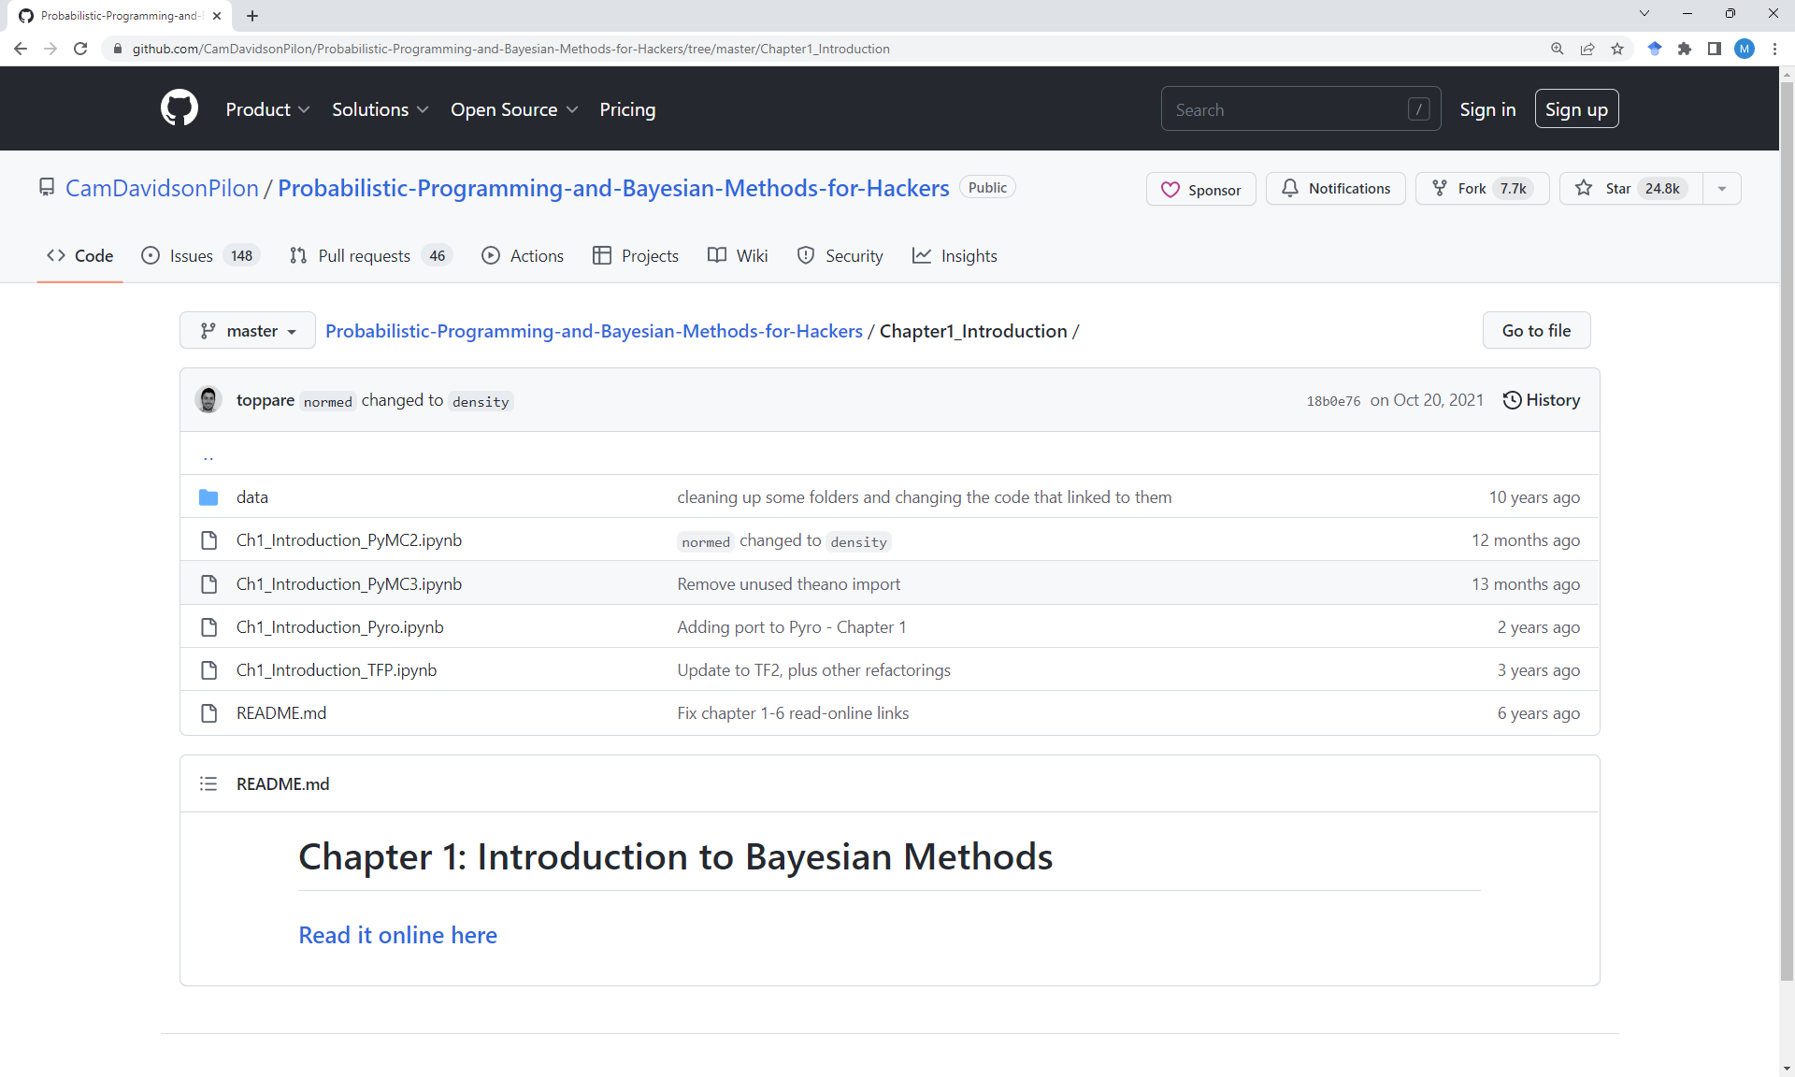

Slide 41
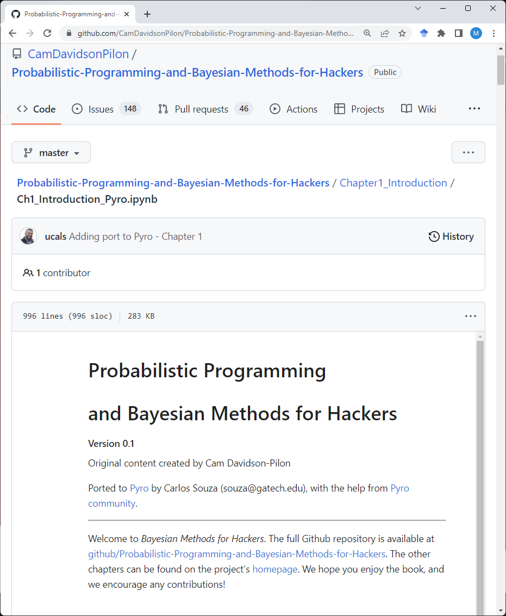

Slide 42
“Hello World!”

Slide 43

Monty Hall Problem
Suppose you're on a game show, and you're given the choice of three doors: Behind one door is a car; behind the others, goats. You pick a door, say No. 1, and the host, who knows what's behind the doors, opens another door, say No. 3, which has a goat. He then says to you, "Do you want to pick door No. 2?" Is it to your advantage to switch your choice?

Slide 44


Monty Hall Problem
Suppose you're on a game show, and you're given the choice of three doors: Behind one door is a car; behind the others, goats. You pick a door, say No. 1, and the host, who knows what's behind the doors, opens another door, say No. 3, which has a goat. He then says to you, "Do you want to pick door No. 2?" Is it to your advantage to switch your choice?

Slide 45

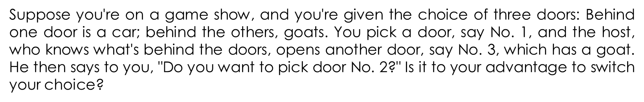
Monty Hall Problem

Slide 46
Gen Solution
using Statistics
using Gen
@gen function monty_hall_model()
car_door = {:car_door} ~ uniform_discrete(1, 3)
picked_door = {:picked_door} ~ uniform_discrete(1, 3)
preference = {:preference} ~ uniform_discrete(0, 1)

Slide 47
Gen Solution
function host_choice()
if car_door != picked_door
return 6 - car_door - picked_door
end
if car_door == 1
left = 2
right = 3
else
left = 1
if car_door == 2
right = 3
else
right = 2
end
end
return preference == 1 ? right : left
end

Slide 48
Gen Solution
function changed_door()
return 6 - host_choice() - picked_door
end
return changed_door()
end

Slide 49
Gen Solution
traces = [Gen.simulate(monty_hall_model, ()) for _=1:40000];
# println(traces[1][:car_door])
# println(traces[1][:picked_door])
# println(traces[1][])
print("probability to win of a player who stays with the initial choice: ")
println(mean([traces[i][:car_door] == traces[i][:picked_door] for i=1:40000]))
print("probability to win of a player who switches: ")
println(mean([traces[i][:car_door] == traces[i][] for i=1:40000]))

Slide 50
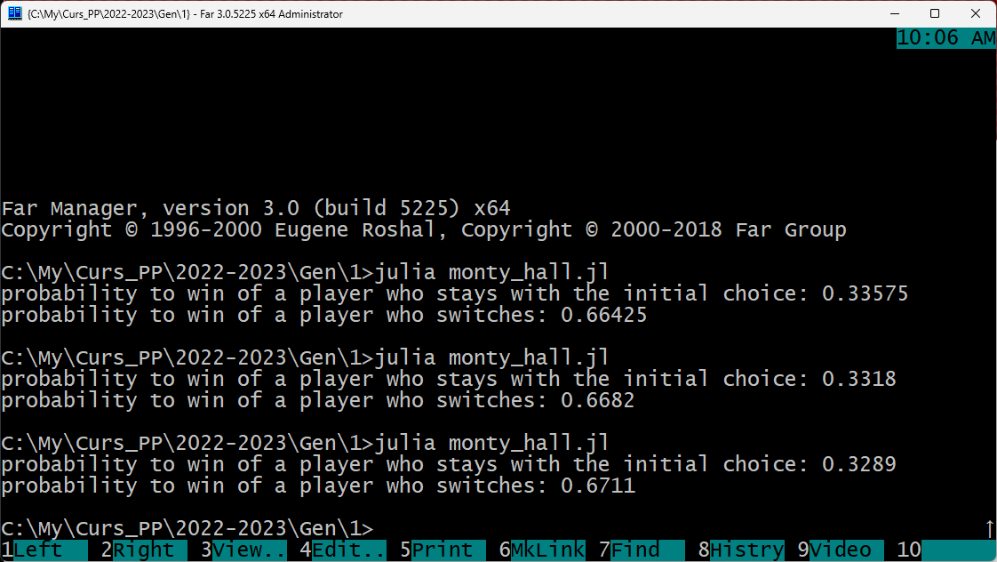
Gen Solution

Slide 51
Administrative Details

Slide 52
Two Project Assignments
 | Release date | Due date
Project 1 | Week 7 | Week 10
Project 2 | Week 11 | Week 14
The two assignments will be graded from 0 to 10
Collaboration: All students must work individually
Any late submissions are penalized at a rate of 20% per week

Slide 53
Grading
Project 1 – 35%
Project 2 – 35%
Exam - 30%

